Slide 1
North-American Design Engineers: A Success Story
2013 Salary Survey Insights
Sponsored by:

Slide 2
Methodology
In June 2013, the Design News team sent an email invitation to 190,341 North American
members of the design-engineering community of Design News. Explorations and Insights,
LLC designed and executed the study and Research Results, an independent research firm, tabulated the survey data.
The survey evaluated compensation, job satisfaction and investigated the following areas:
Current salary and bonus and how that compares to a year ago
Length of employment
Engineering disciplines
Level of job stress compared to previous year
Reasons for job stress
Impact of economy
Level of supervisory and/or budgetary responsibility compared to previous year
Average work hours weekly
Level of satisfaction as a design engineer
Reasons for job satisfaction and dissatisfaction
Challenges of job
Size of company
Company’s major product line
Results are based on 2,125 usable survey responses. At a 95% confidence level, results are accurate and projectable within a + or – 2.1% margin of error.

Slide 3
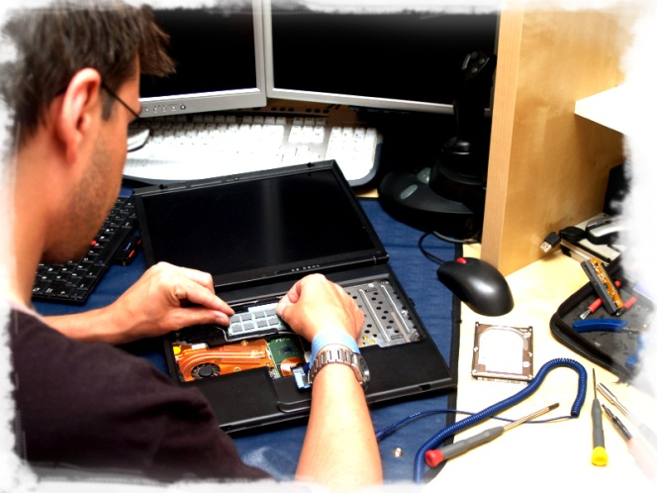
The Design Engineer
Average Salary:
$100,664
Average # of years in current position:
9 years
Average Bonus:
$10,537
Average Age:
49
Education:
Degree in engineering, 90%
Average # of years as an engineer :
18 years
Average # of years with present employer:
13 years
Average hours work per week:
46

Slide 4
Section I
Salary and Compensation

Slide 5
Current Base Annual Salary
for 2013
(excluding bonus, commissions, etc.)
Average Salary: $100,664
Median Salary: $95,097
June 2013

Slide 6
If your base salary changed over the past 12 months, by how much?
How does your base annual salary compare with 2012?
Average Salary Increase: 4%
Median Salary Increase: 3%
Average Salary Decrease: 25%
Median Salary Decrease: 10%
June 2013
:

Slide 7
How much will you earn in bonuses,
commissions, etc.?
(not including base salary in 2013)
Average Expected Bonus: $10,537
June 2013

Slide 8
How does your 2013 bonus, commission, etc. plan compare with 2012?
Bonus, commission, etc. plan increase/decrease compared to 2012
Average Increase in bonus: 27%
Median Increase in bonus: 5%
Average Decrease in bonus: 37%
Median Decrease in bonus: 25%

Slide 9
Section II
Careers in Engineering

Slide 10
How long have you been an engineer?
Primary Engineering Discipline
(i.e. mechanical or electrical design)
 | % of respondents
Electrical/electronics engineering | 33%
Mechanical engineering | 30%
Manufacturing engineering | 8%
Software engineering | 8%
Controls engineering | 5%
Electromechanical | 4%
Materials engineering | 2%
Other | 10%
Average years: 18

Slide 11
Years Worked in Present Job
Years Worked in Present Company
Average years: 9
Average years: 13

Slide 12
Educational Background
Age Group
Average age: 48

Slide 13
In an average week, how many hours do you work?
How has the number of hours you work each week changed over the past year?
Average hours: 46

Slide 14
Do you have supervisory and/or budget responsibility?
If you are supervising people, how has this changed during the past two years?
Same 52%
More people 31%
Fewer people 17%

Slide 15
Number of employees supervising today
vs. the number supervised in 2011?
Average number of employees
supervised in 2013: 9
Average number of employees
supervised in 2011: 8

Slide 16
Please rate your level of agreement with the statements below pertaining to your role as an engineer.

Slide 17
Do you have hiring responsibilities?

Slide 18
Section III
Job Satisfaction

Slide 19
What factors contribute to being satisfied with your job?
What factors greatly impact on your dissatisfaction with your current job?
 | % of respondents
Problem solving | 73%
Technical challenges | 71%
Opportunity to be creative | 63%
Salary | 62%
Location | 58%
Benefits | 57%
Opportunity for new challenges | 54%
Relationships with colleagues | 54%
Variety of projects | 54%
Job security | 52%
Recognition from peers | 45%
Company’s financial stability | 42%
Recognition from management | 42%
Relationship with boss | 36%
Advancement opportunities | 30%
Company size | 26%
Relationships with subordinates | 26%
Opportunity for job training | 21%
Travel | 20%
Managing people | 10%
Other | 2%
 | % of respondents
No room for advancement | 73%
Company politics | 66%
Salary | 62%
No recognition | 60%
Not challenging enough | 43%
Stress level too high | 42%
Workload | 36%
Lack of benefits | 34%
Lack of adequate technology | 32%
Company unstable | 28%
Outsourcing | 21%
Colleagues | 15%
Location | 9%
Other | 9%
Base: Not Very/Not At All satisfied with career in design engineering
Base: Extremely/Somewhat satisfied with career in design engineering

Slide 20
In general, how satisfied are you with your career in design engineering?
56% are Extremely/Very satisfied with their design engineering career
“GM hiring engineers with no degrees.”
“Develop medical advancements
“Mucky mucks only want money.”
“Relationships with clients”
“Importance of my work in the defense sector”
“Engineering freedom”
“Opportunity to be FIRST robotics mentor”

Slide 21
How challenging is your job?
What factors do you find most challenging?
 | % of respondents
Workload | 46%
Balancing work with home/ personal life | 41%
Keeping up with technology | 34%
Lack of career development | 27%
Working with outdated equip./technology | 26%
Need to learn more skill sets | 23%
Company stability | 19%
Company downsizing | 18%
Global design teams | 16%
Work conditions | 12%
Poor relationships with co-workers | 10%
Other | 7%
51% Extremely/Very Challenging
Base: Find job Extremely/Very/Somewhat challenging
How stressful is your job compared to two years ago?

Slide 22
How concerned or secure do you feel about your job
in the current economic climate?
“Plastics industry is booming and looks to be almost recession proof.”
“Government funded – enough said”
20% are Extremely/Very Concerned with the security of their positions
“Company is getting new business every week.”
“Cannot even find part-time work”
“Foreign competition and rumors of downsizing”

Slide 23
Why do you feel this way about your job security?
Reasons are Primarily a Function of:
 | % of respondents
Concerned (Net) | 55%
Concern is a function of:
Company | 28%
Economy | 15%
Politics | 8%
Industry | 8%
Individual’s situation | 7%
Unconcerned (Net) | 42%
Lack of concern a function of:
Individual’s situation | 22%
Company | 17%
Industry | 9%
Economy | 4%
Misc. | 4%

Slide 24
Has your company experienced the following in the last 12 months?
What percentage of your engineering workforce was reduced?
Average reduction: 15%

Slide 25
Has your company experienced the following in the last 12 months?
What percentage of your engineering workforce was increased?
Average increase: 13%

Slide 26
Which of the following have you personally
experienced in the last 12 months?

Slide 27
How actively are you seeking another job?

Slide 28
Would you recommend this field
to your son, daughter or to a
friend?

Slide 29
Do you subscribe to the print edition of
Design News?

Slide 30
Section IV
Demographics

Slide 31
How many people does your company employ and how many work as engineers?
Average number of people
employed at a company: 768
Average number of engineers
employed at a company: 497

Slide 32
What is your company’s major product
line?
 | % of respondents
Aerospace | 12%
Medical | 9%
Automotive | 7%
Defense Systems | 7%
Semiconductors | 6%
Industrial Controls | 5%
Instruments/Test Equipment | 5%
Communication Systems | 4%
Consumer Electronics | 4%
Contract Manufacturing | 3%
Computers/Peripherals | 3%
Electronic Components | 3%
Machine Tools | 2%
Other | 30%

Slide 33
In which region do you work?
(Average salaries for each region, excluding
Alaska, Hawaii, Canada, Mexico)
Pacific NW
(WA,OR)
New England
(ME, NH, VT, MA, RI, CT)
8%
$104,708
5%
$97,232
Mountain
(MT, ID, UT, WY, CO, NM)
Midwest
(MI, OH, KY, TN, IN, WI, IL, IA, MO, ND, SD, NE, KS)
5%
$106,881
Mid-Atlantic
(NY, PA, NJ, DE, MD, WV, VA, D.C.)
Southwest
(CA, NV, AZ)
31%
$91,533
16%
$116,227
13%
$100,102
South
(AL, MS, AR, LA, OK, TX)
Southeast
(NC, SC, GA, FL)
9%
$109,985
6%
$99,730

Slide 34
Section V
Salary Performance vs. Metrics

Slide 35
Average Total Compensations (Salary + Bonus)
Company Size (Number of Employees)

Slide 36
Average Total Compensations (Salary + Bonus)
Years of Age
**Small base size, interpret with caution

Slide 37
Average Total Compensations (Salary + Bonus)
Levels of Education

Slide 38
Average Total Compensations (Salary + Bonus)
Number of Hours Worked

Slide 39
Average Total Compensations (Salary + Bonus)
Number of Years at Present Job

Slide 40
Average Total Compensations (Salary + Bonus)
Job Satisfaction

Slide 41
Average Total Compensations (Salary + Bonus)
Number of Years of Experience as an Engineer

Slide 42
Average Total Compensations (Salary + Bonus)
Job Discipline: Engineering

Slide 43
Average Total Compensations (Salary + Bonus)
Regions

Slide 44
Average Total Compensations (Salary + Bonus)
Industries

Slide 45
Average Total Compensations (Salary + Bonus)
Industries, cont’d

Slide 46
Thank You To learn more please contact: Rich Nass, Design News Brand Director
rich.nass@ubm.com
(201) 288-1904
Or visit us online at www.designnews.com

